Slide 1
Priority Queue
Continuation
2025.02.28

Slide 2
Priority Queue
C++: std::priority_queue.
Python: heapq.
Java: PriorityQueue.
C#: PriorityQueue.

Slide 3
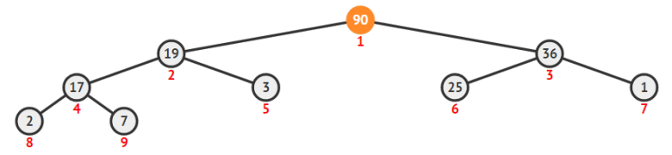
Binary Heap – Advantages
Can be stored as an 1D-array – cache friendly.
Simple navigation using bit operations:
i >> 1 – to parent
i << 1 – to left child
(i << 1) + 1 – to right child
Example: { -, 90, 19, 36, 17, 3, 25, 1, 2, 7 }

Slide 4
Binary Heap – Property
Each subtree rooted at X, items on the left and on the right subtree of X are smaller or equal to X.
The property ensures that the top element is always maximum.
Priority Queue is usually implemented using heaps.
Priority Queue is an Abstract Data Type, there are many ways to implement it!

Slide 5
Binary Heap
Insert Element

Slide 6
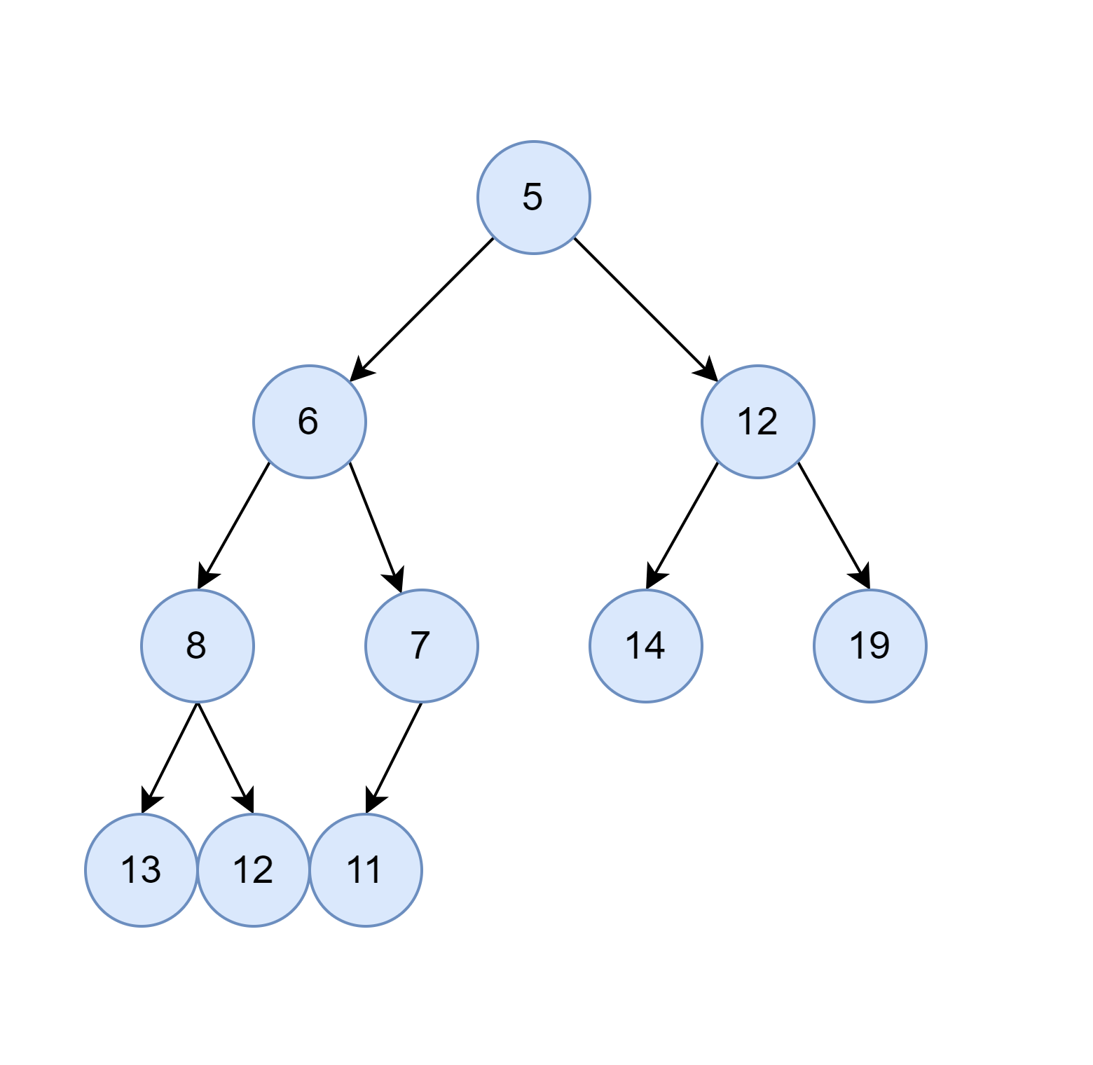
Binary Heap – Insert Element (1) – I
Let's assume we want to insert element [1] into the heap.

Slide 7
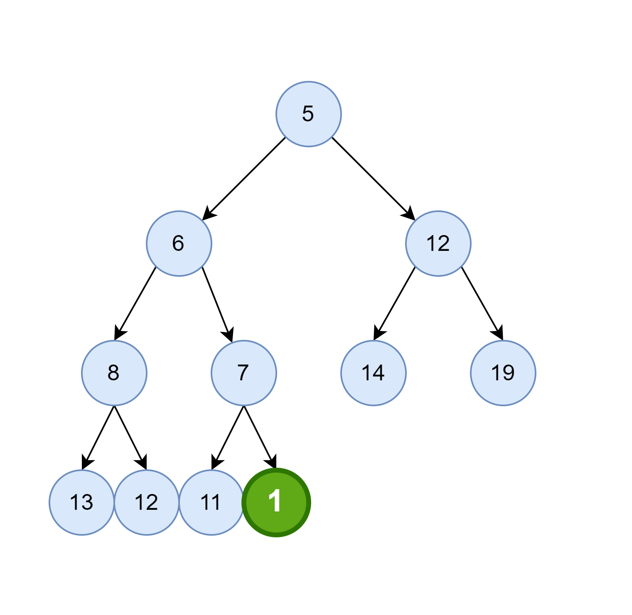
Binary Heap – Insert Element (1) – II
Insert it in the first available insert position.
Violation! Element 1 is less than 7!

Slide 8
Binary Heap - Question
How can you determine the position of the last element in a binary heap?

Slide 9
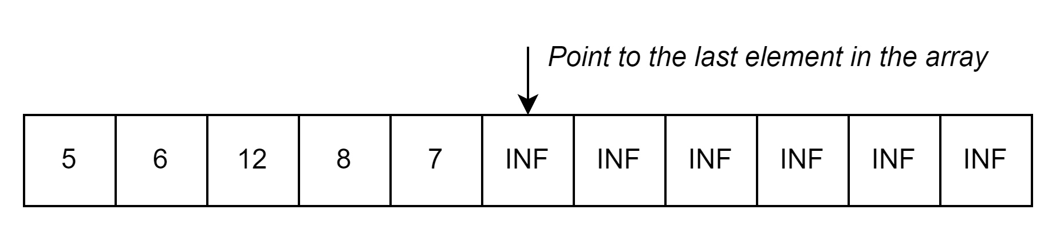
Binary Heap - Question
Q: How can you determine the position of the last element in a binary heap?
A: using an array helps significantly in reducing the complexity.

Slide 10
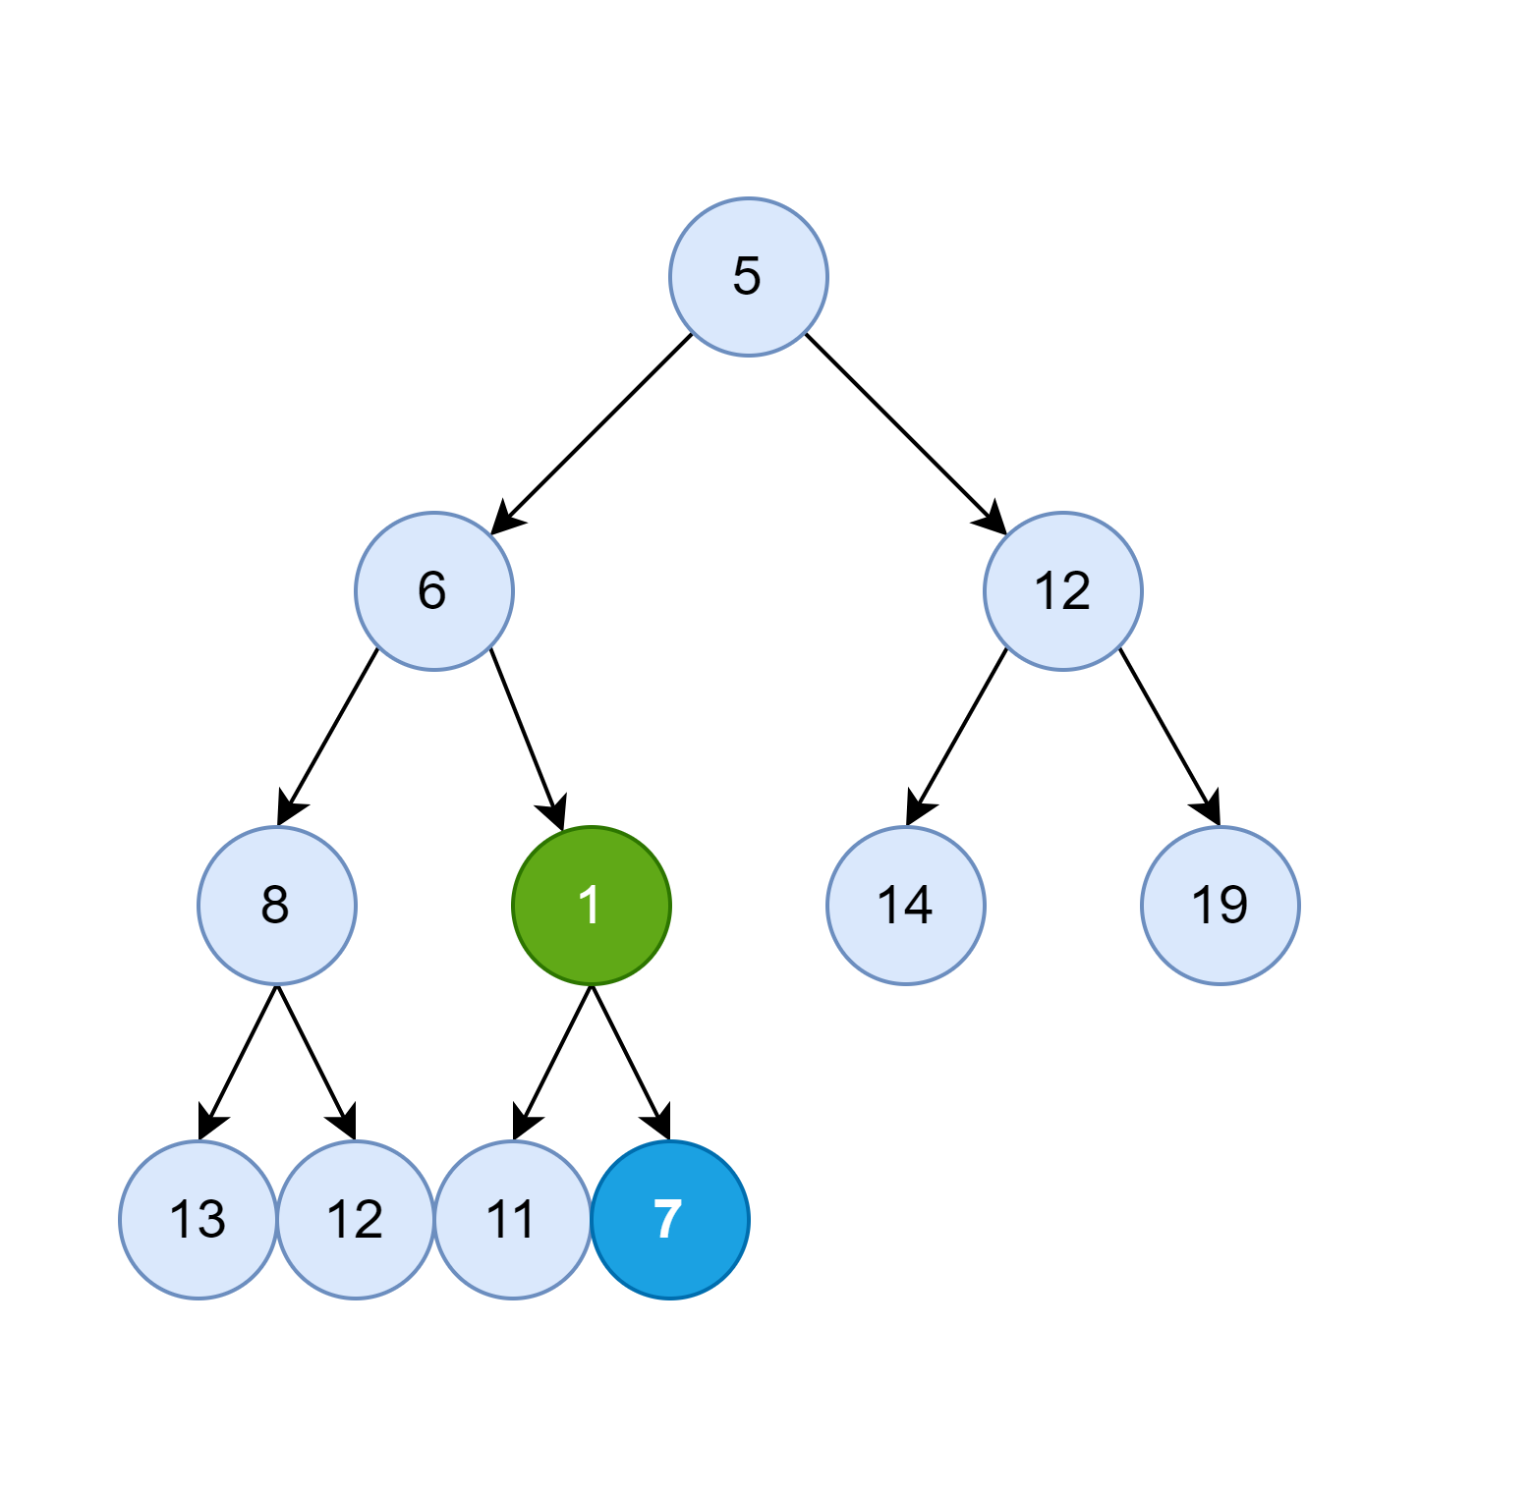
Binary Heap – Insert Element (1) – III
Swap Node 7 and 1.
Violation: 1 < 6!

Slide 11
Binary Heap - Question
How to swap to elements in efficient way?

Slide 12
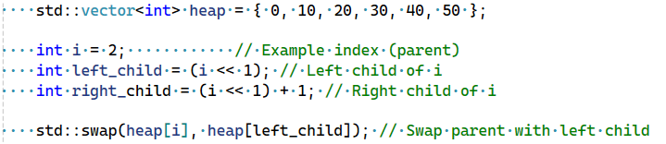
Binary Heap - Question
Q: How to swap to elements in efficient way?
A: Bit manipulations and simple swap in the array.

Slide 13
Binary Heap - Question
How to swap to elements in efficient way?
Answer: using bit manipulations and simple swap in the array.

Slide 14
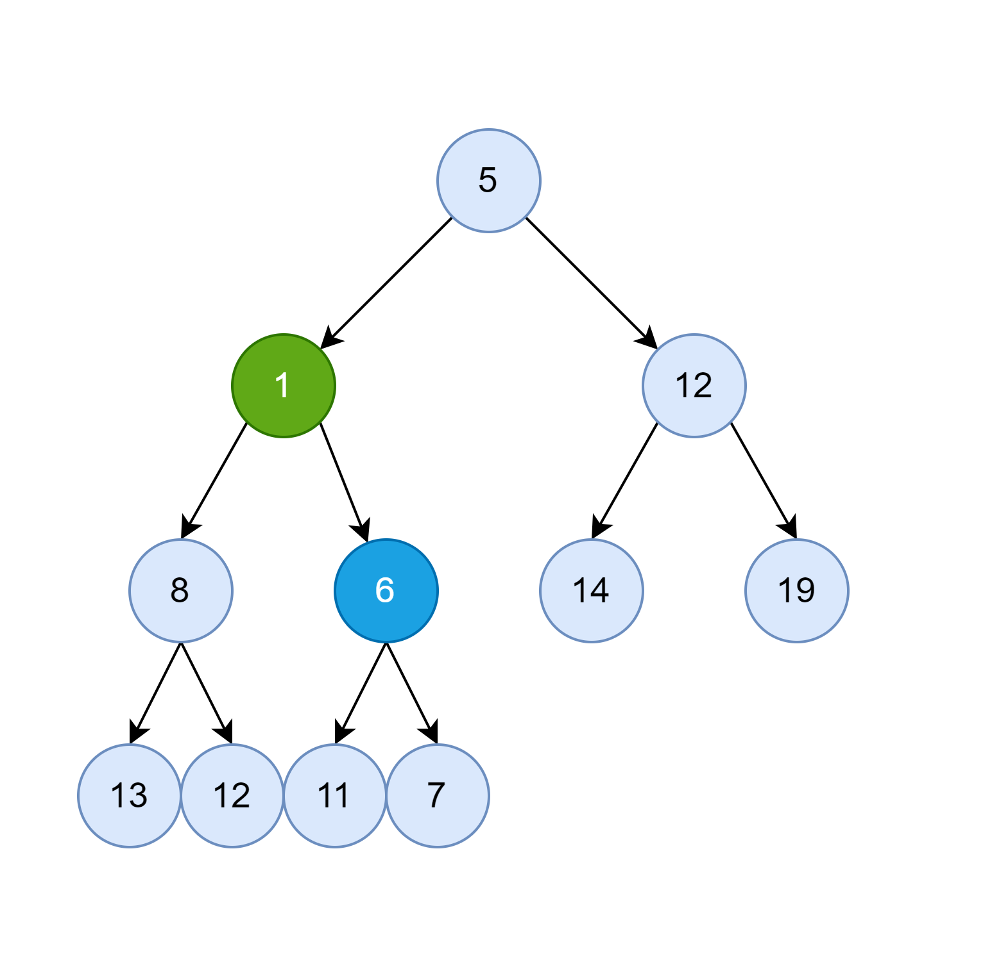
Binary Heap – Insert Element (1) – IV
Swap Node 6 and 1.
Violation: 1 < 5!

Slide 15
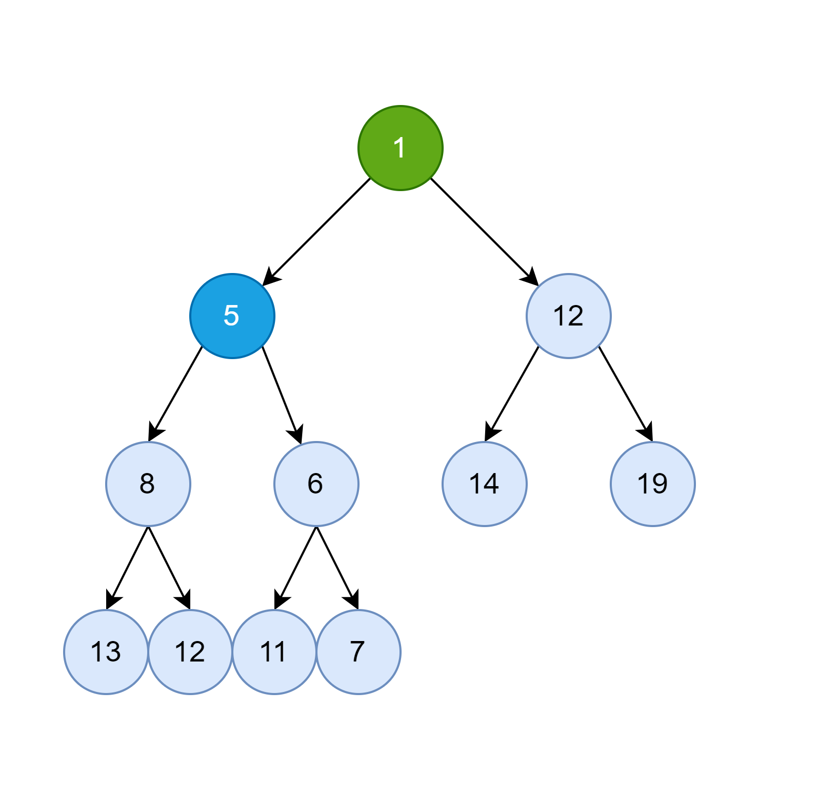
Binary Heap – Insert Element (1) – V
Swap Node 5 and 1.
Done!

Slide 16
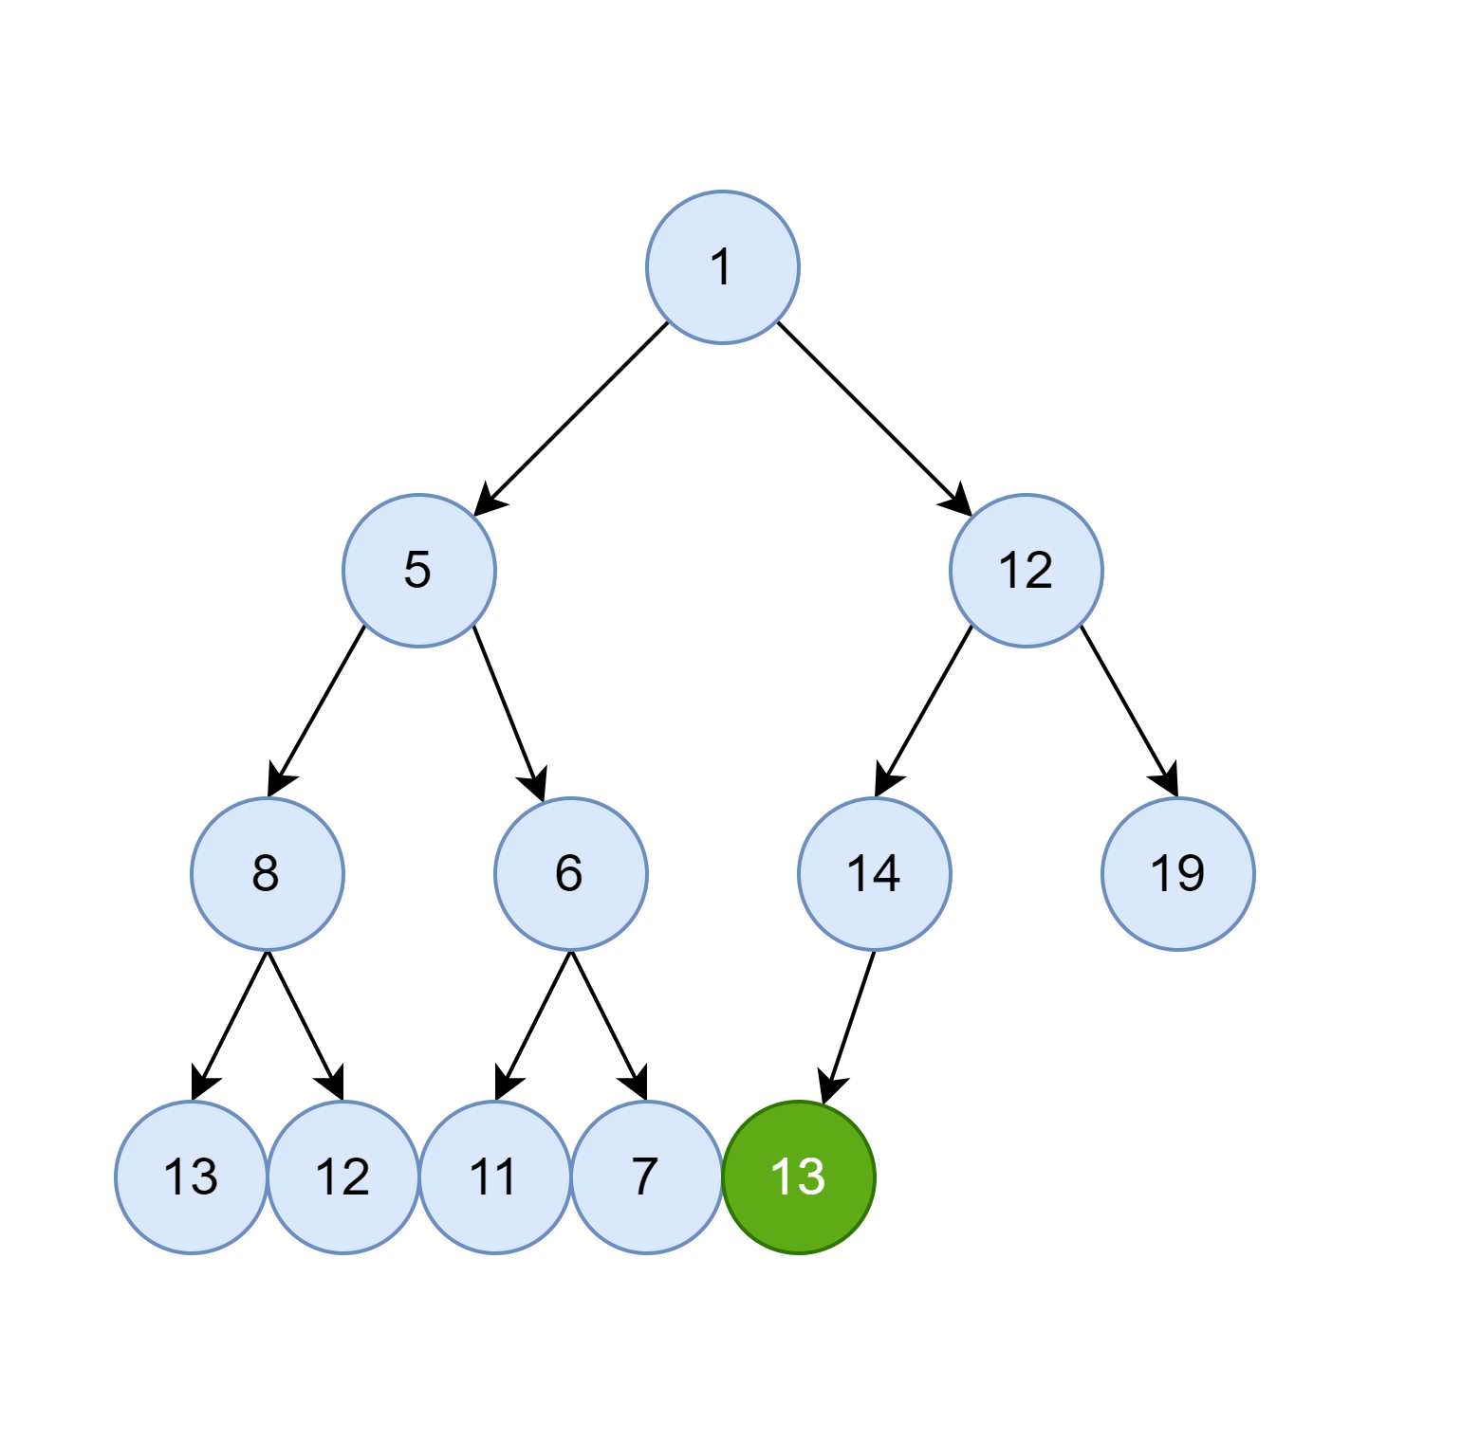
Binary Heap – Insert Element (13) – I
Let's insert element [13].
Violation: 13 < 14!

Slide 17
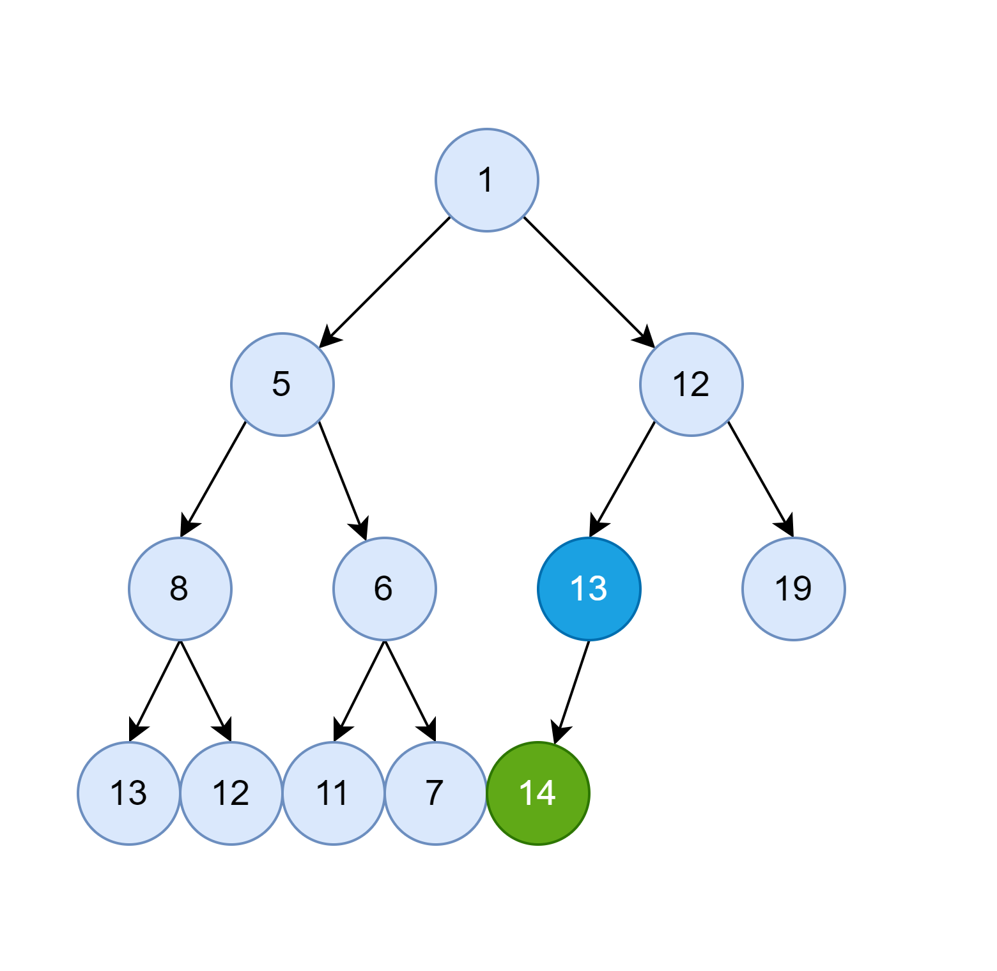
Binary Heap – Insert Element (13) – II
Swap Node 13 and 14.
Done!

Slide 18
Binary Heap
Pop Element

Slide 19
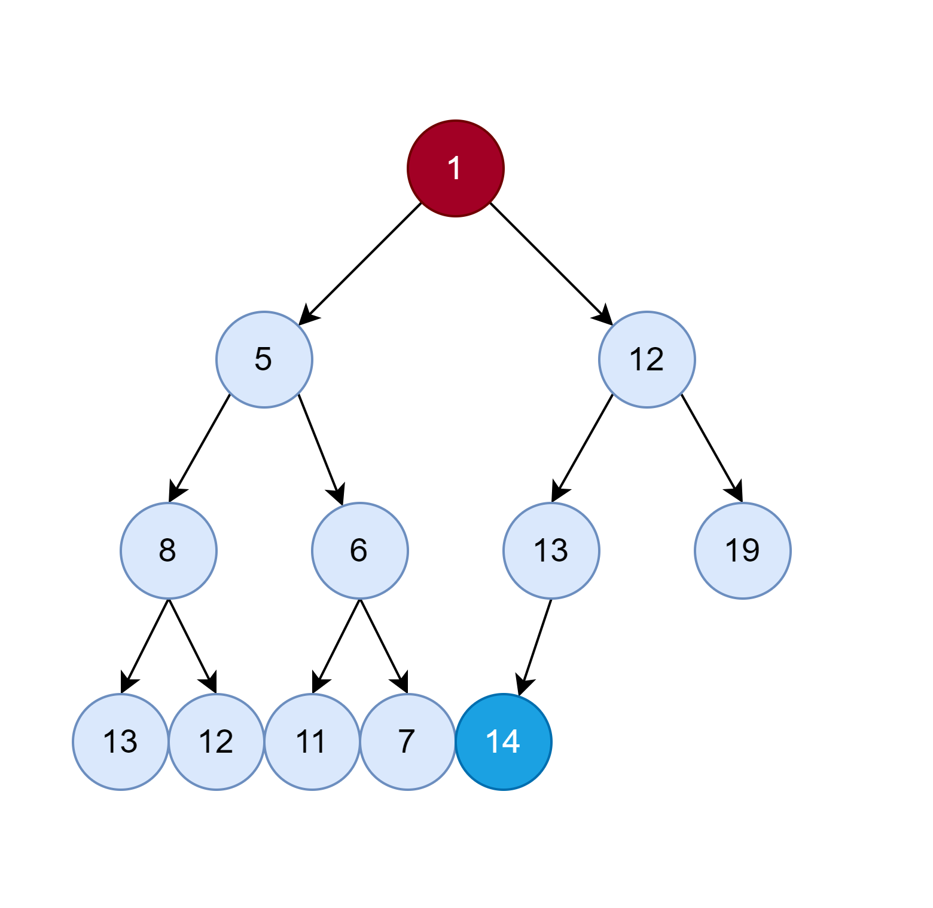
Binary Heap – Pop Element – I
Swap root with the last node

Slide 20
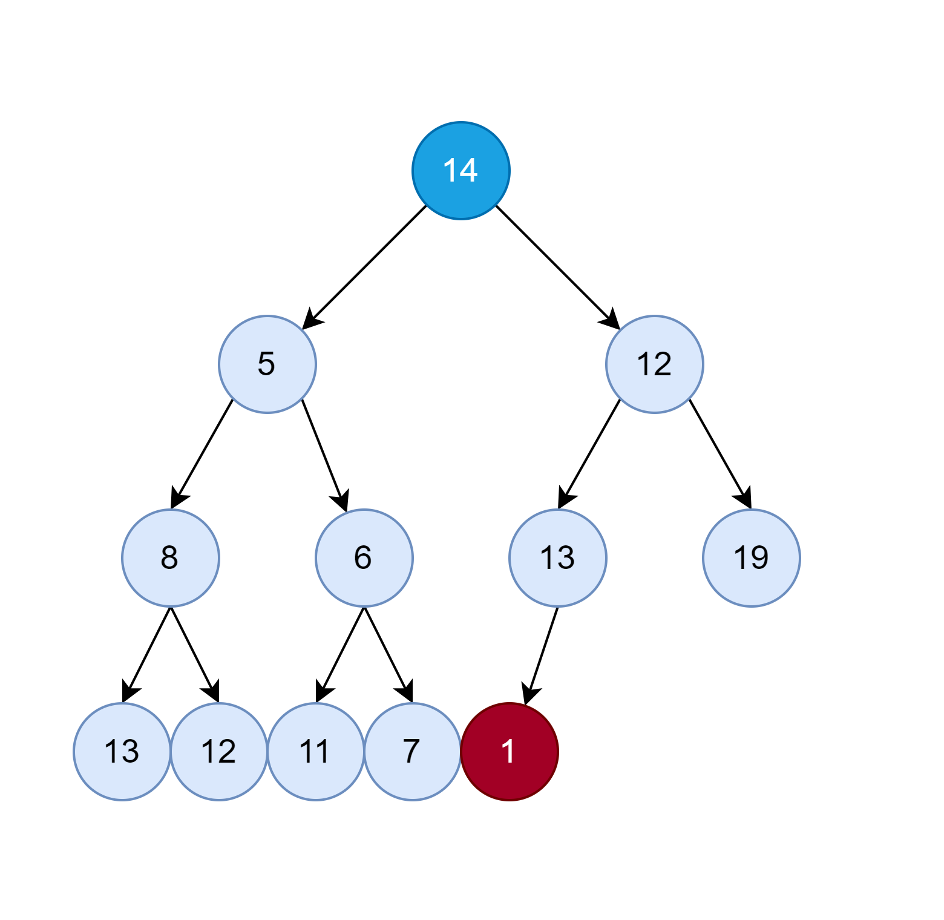
Binary Heap – Pop Element – II
Delete the last element
Violation: 14 > 12 and 14 > 5!

Slide 21
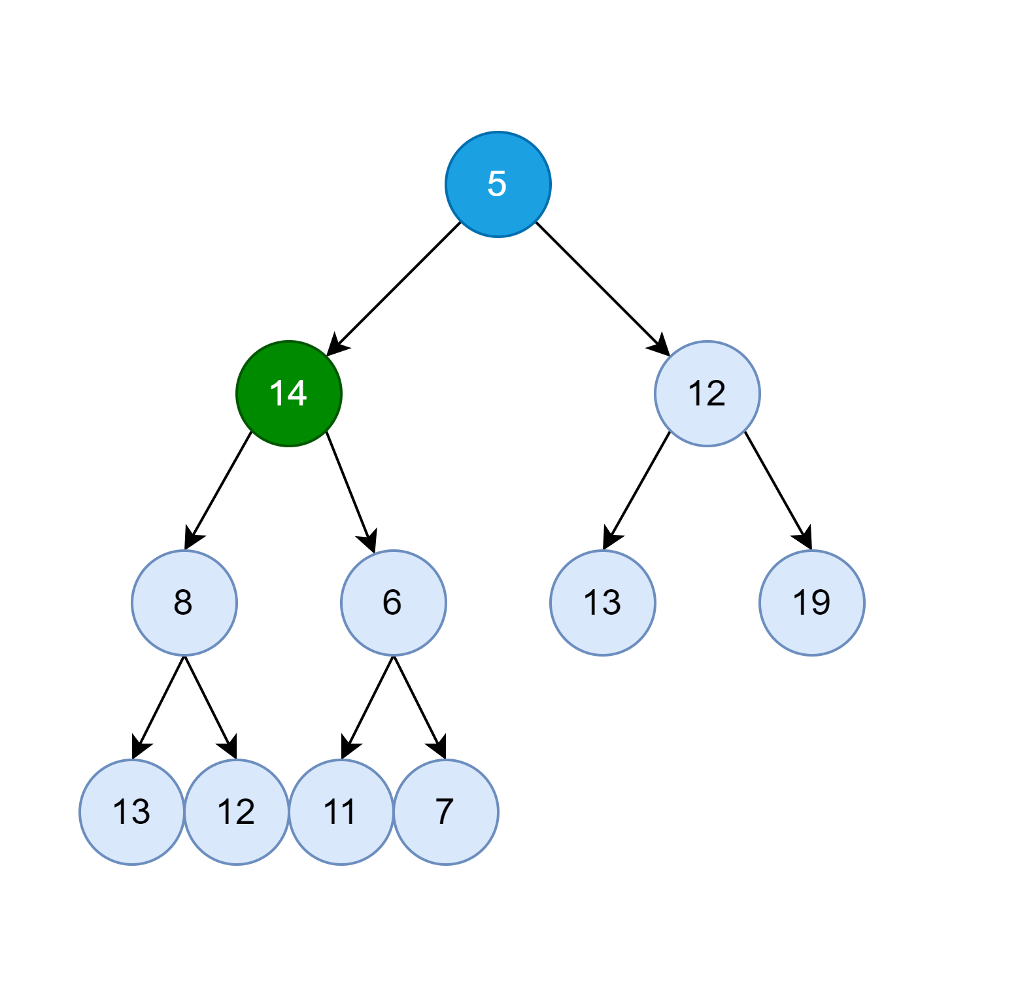
Binary Heap – Pop Element – III
Swap with the smallest child
Violation: 14 > 8 and 14 > 6!

Slide 22
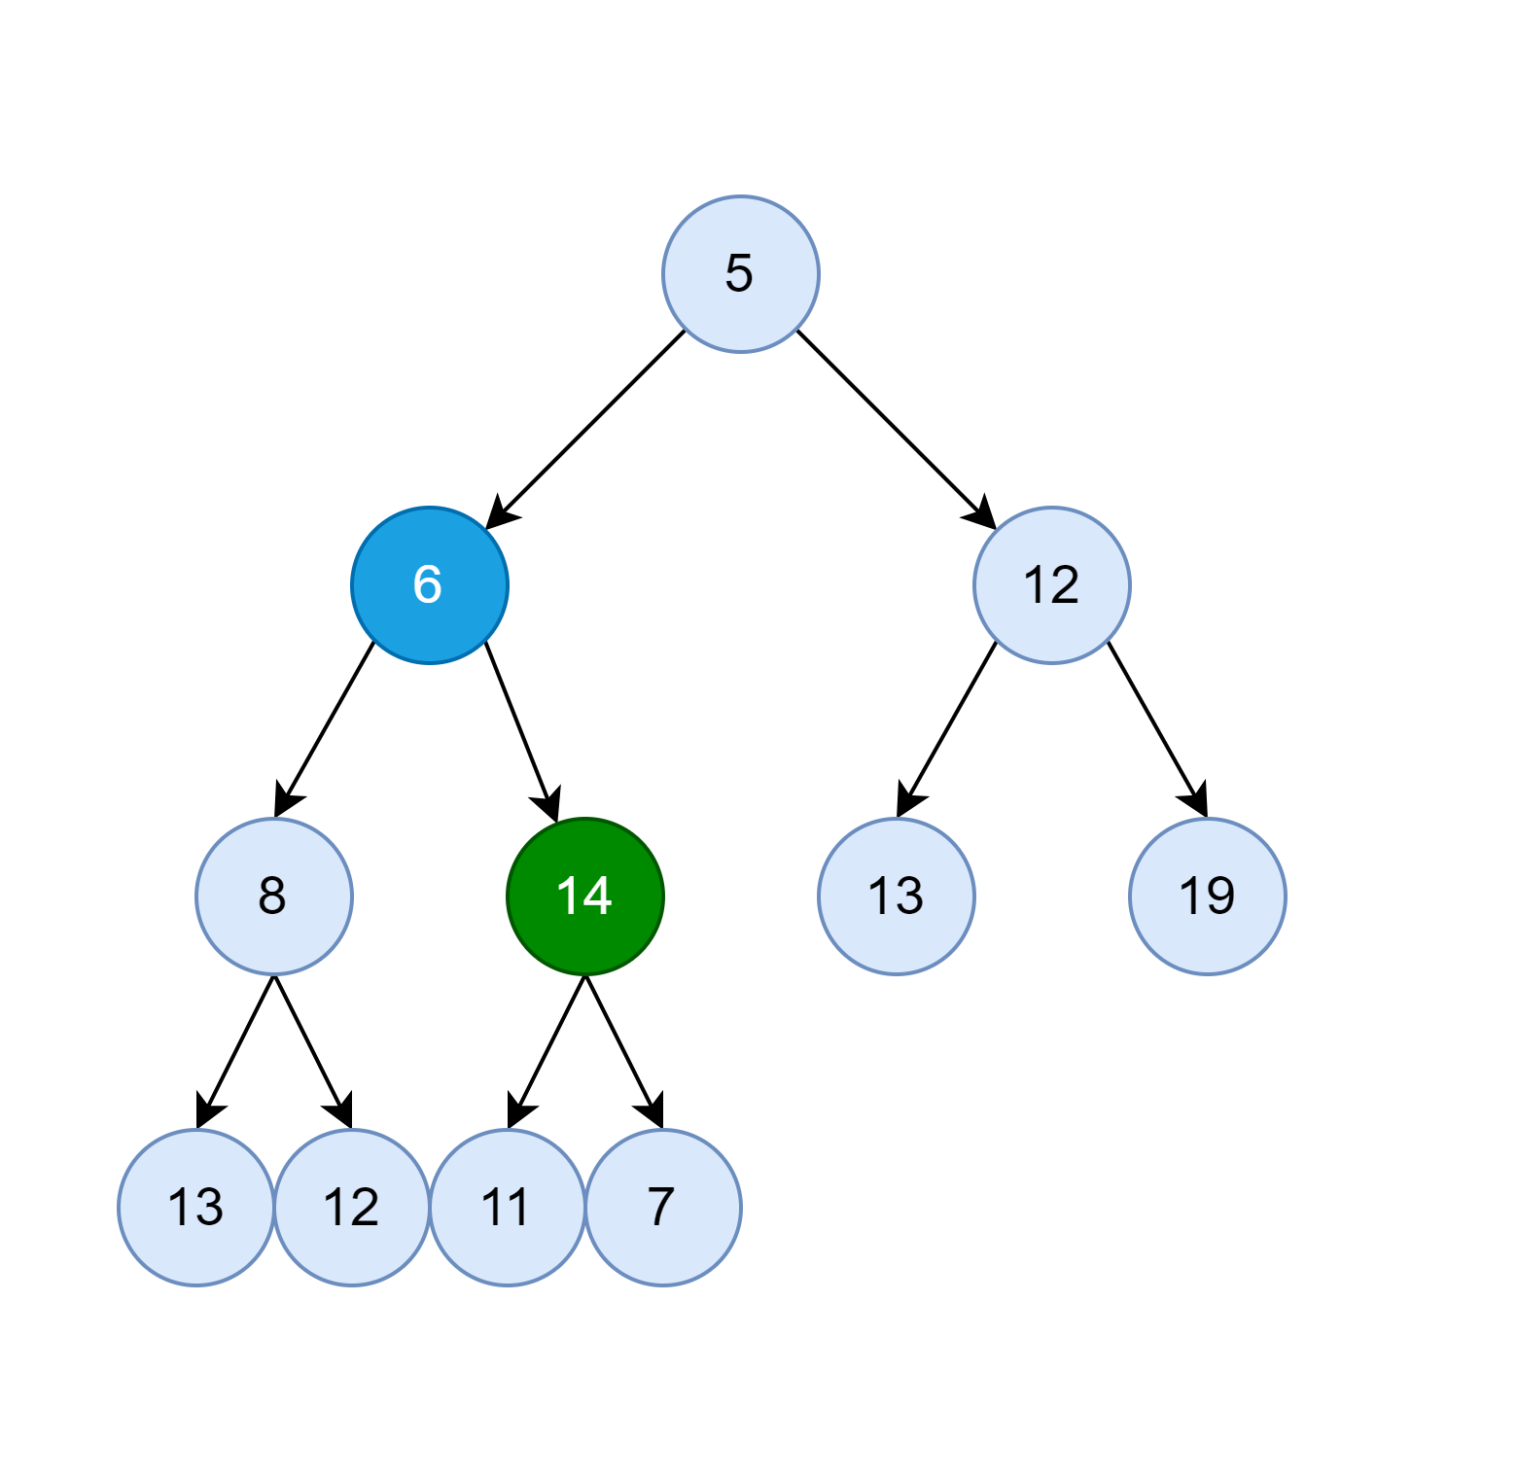
Binary Heap – Pop Element – IV
Swap with the smallest child
Violation: 14 > 11 and 14 > 7!

Slide 23
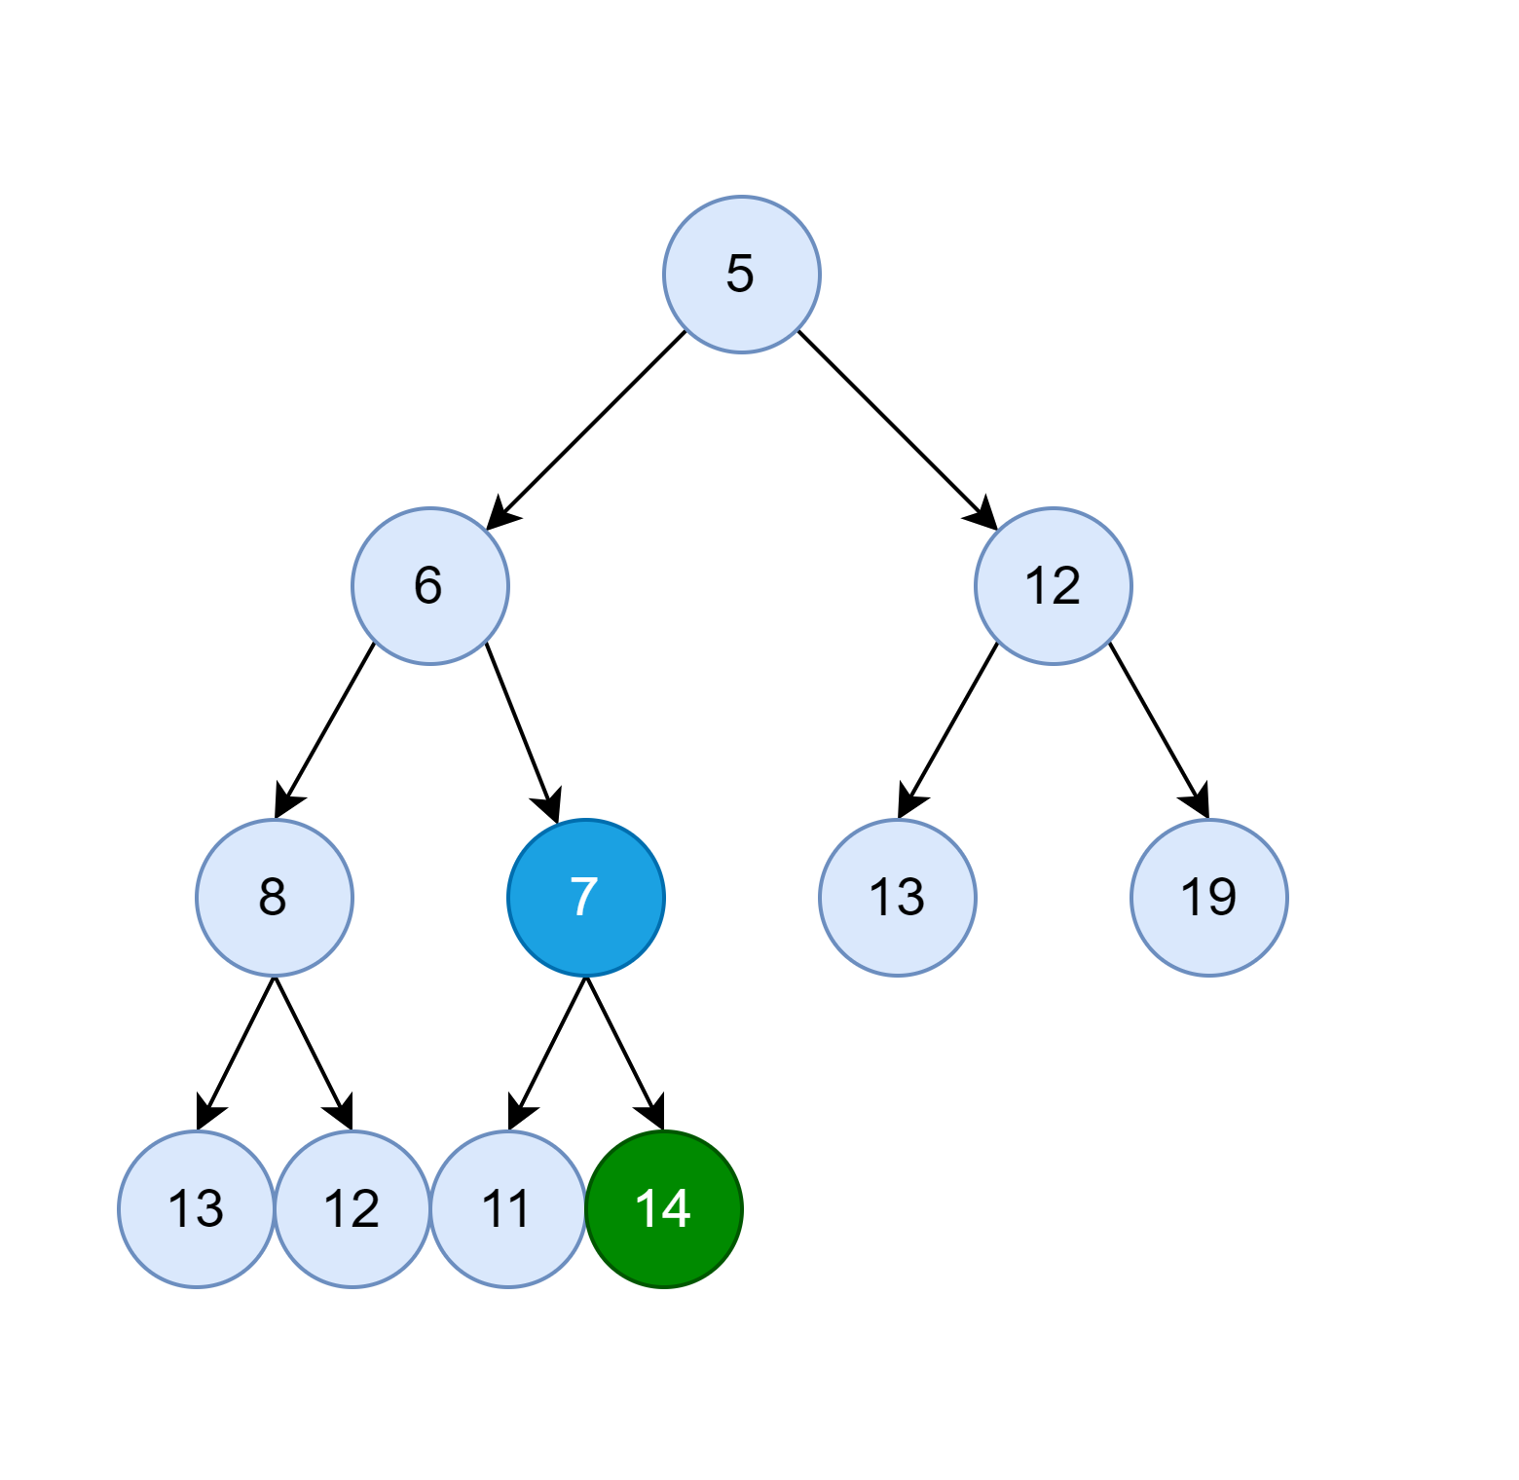
Binary Heap – Pop Element – V
Swap with the smallest child
Done!

Slide 24
Binary Heap
Remove or Search Element
The functions are not used in the Priority Queue!
Requires to search for element in linear way – O(N)!

Slide 25
Binary Heap – Asymptotic Complexity
Operation | Complexity
Get Top (Minimum or Maximum) | O(1)
Pop Top Element | O(log(N))
Insert New Element | O(log(N))
Search Any Element | O(N)
Remove Any Element | O(N)
Use another structure if search or remove is required, for example, Red-Black Tree (Binary Balanced Search Tree).

Slide 26
Priority Queue
Practice

Slide 27
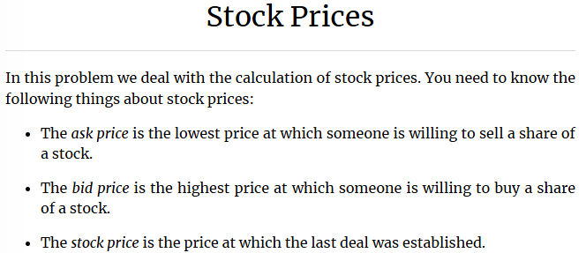
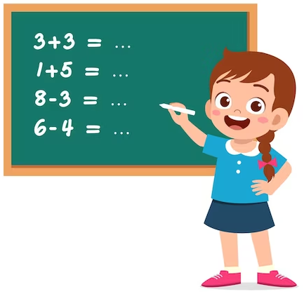
Priority Queue – Stock Prices
Kattis: Stock Prices
Some of you will recognize the task. Indeed, we solve it before. All tasks from the book are solved.

Slide 28
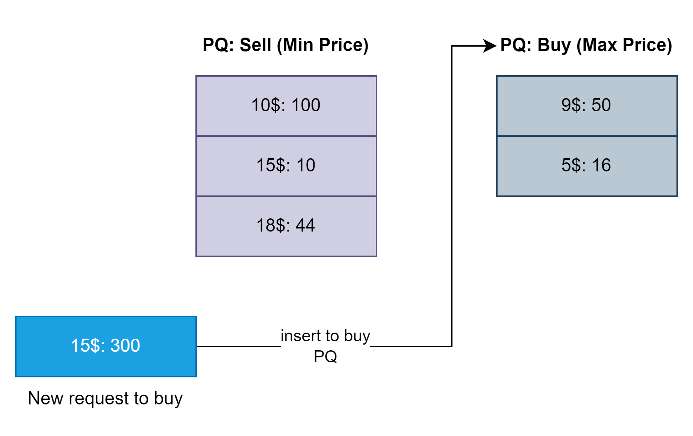
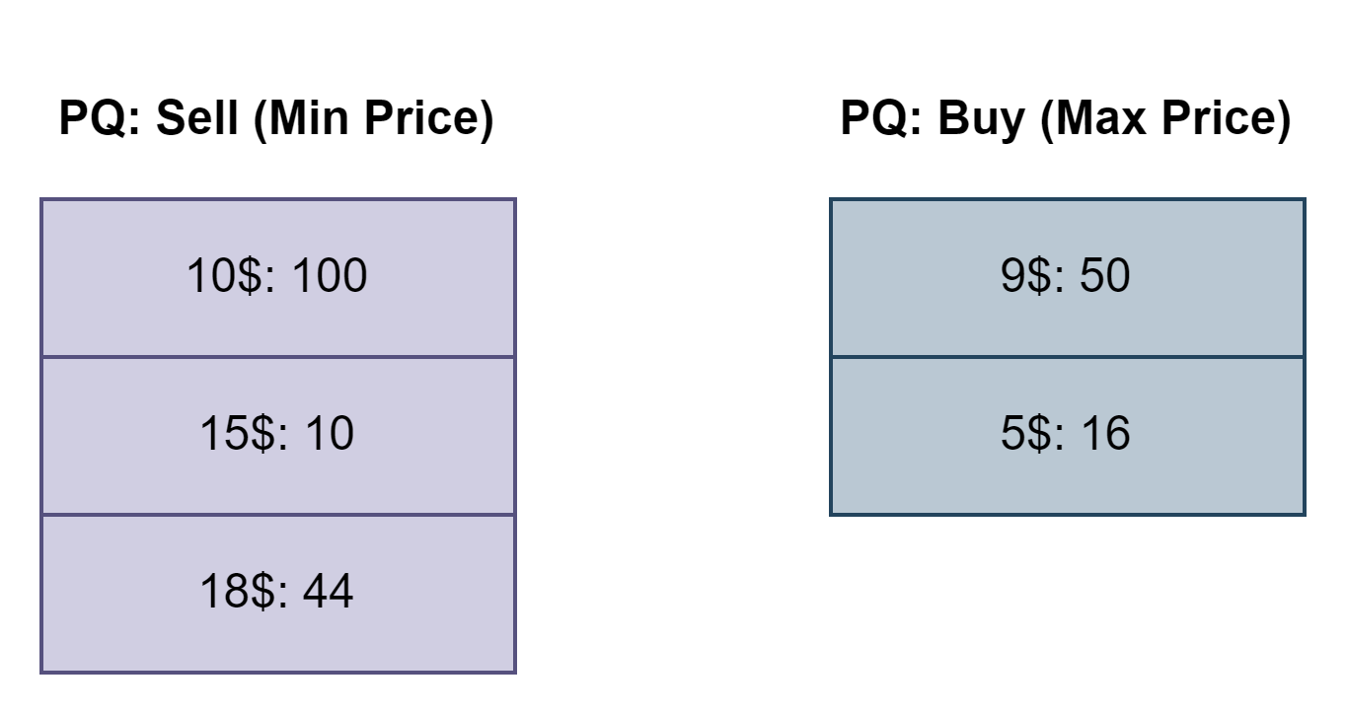



Priority Queue – Stock Prices – Approach
Kattis: Stock Prices

Slide 29
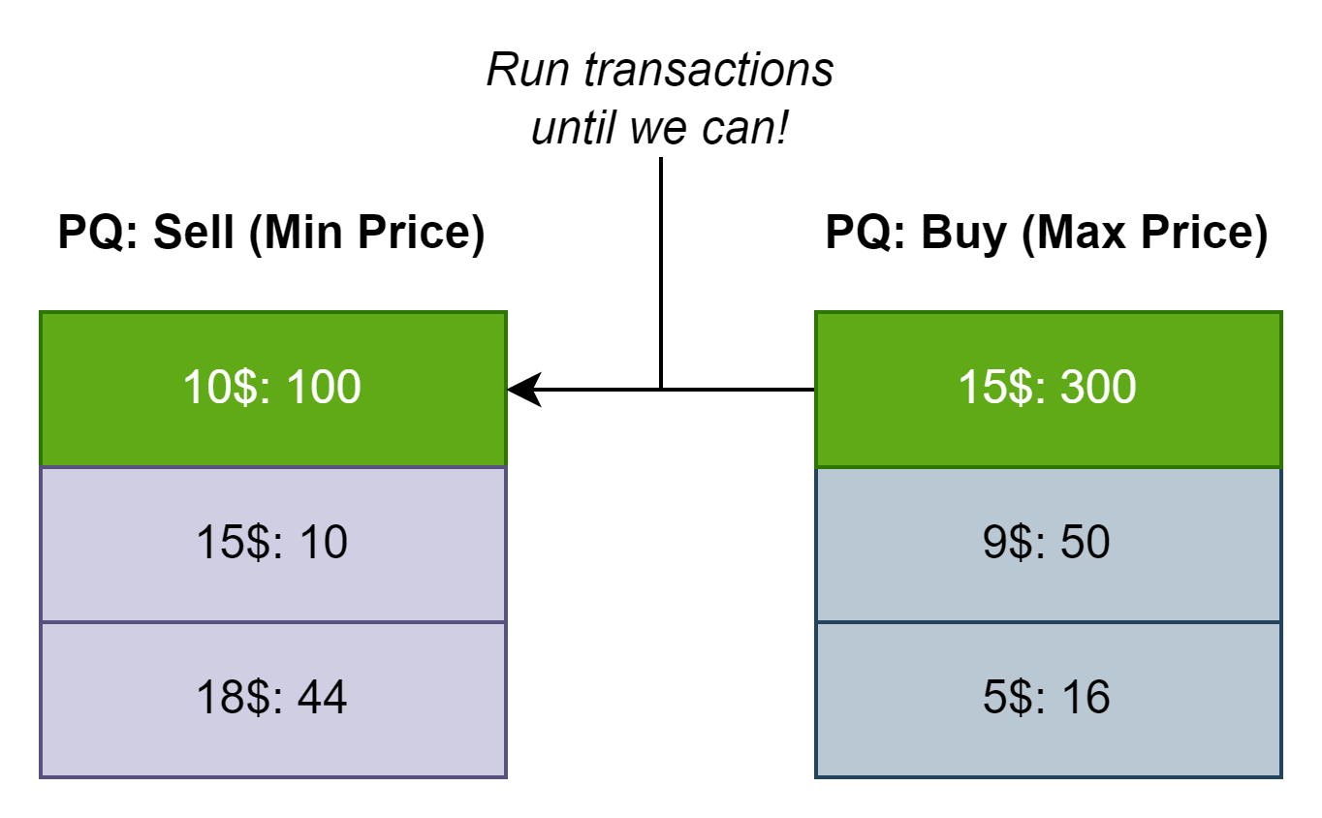





Priority Queue – Stock Prices – Approach
Kattis: Stock Prices

Slide 30
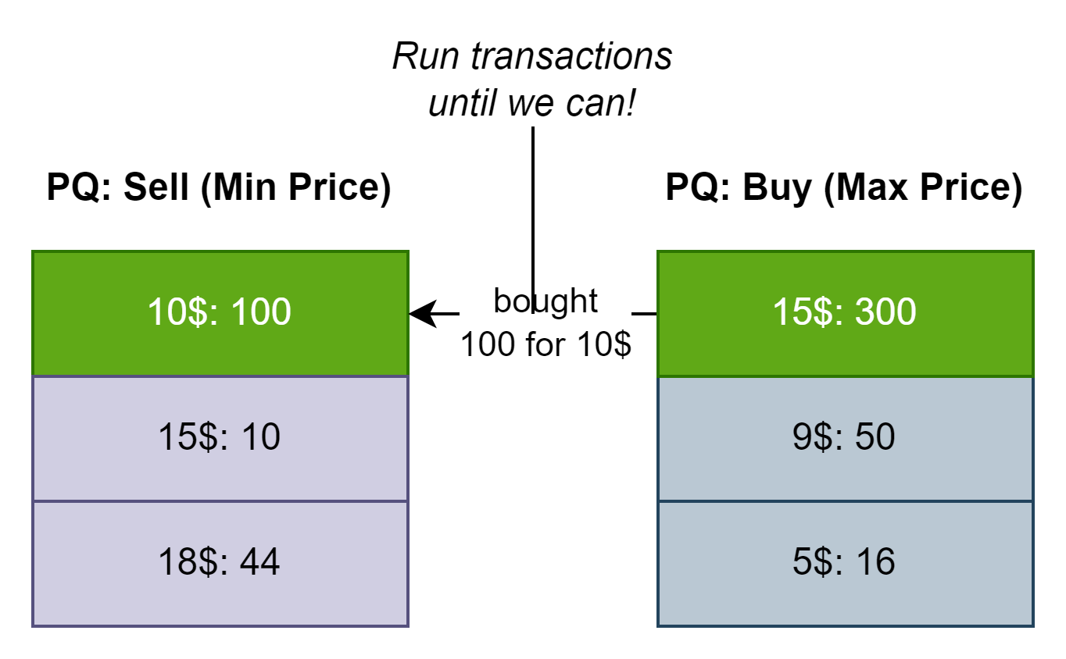
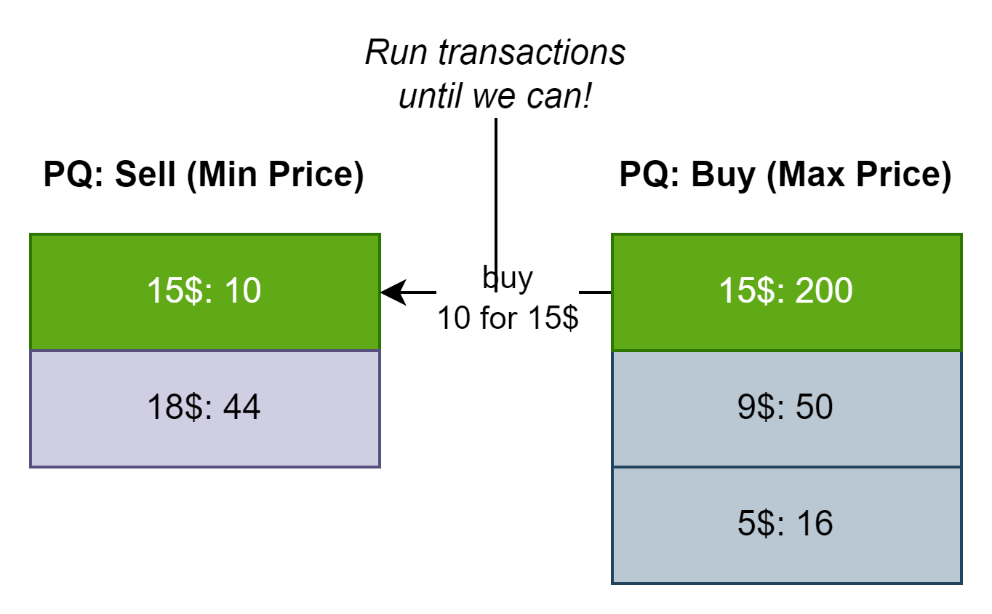





Priority Queue – Stock Prices – Approach
Kattis: Stock Prices

Slide 31
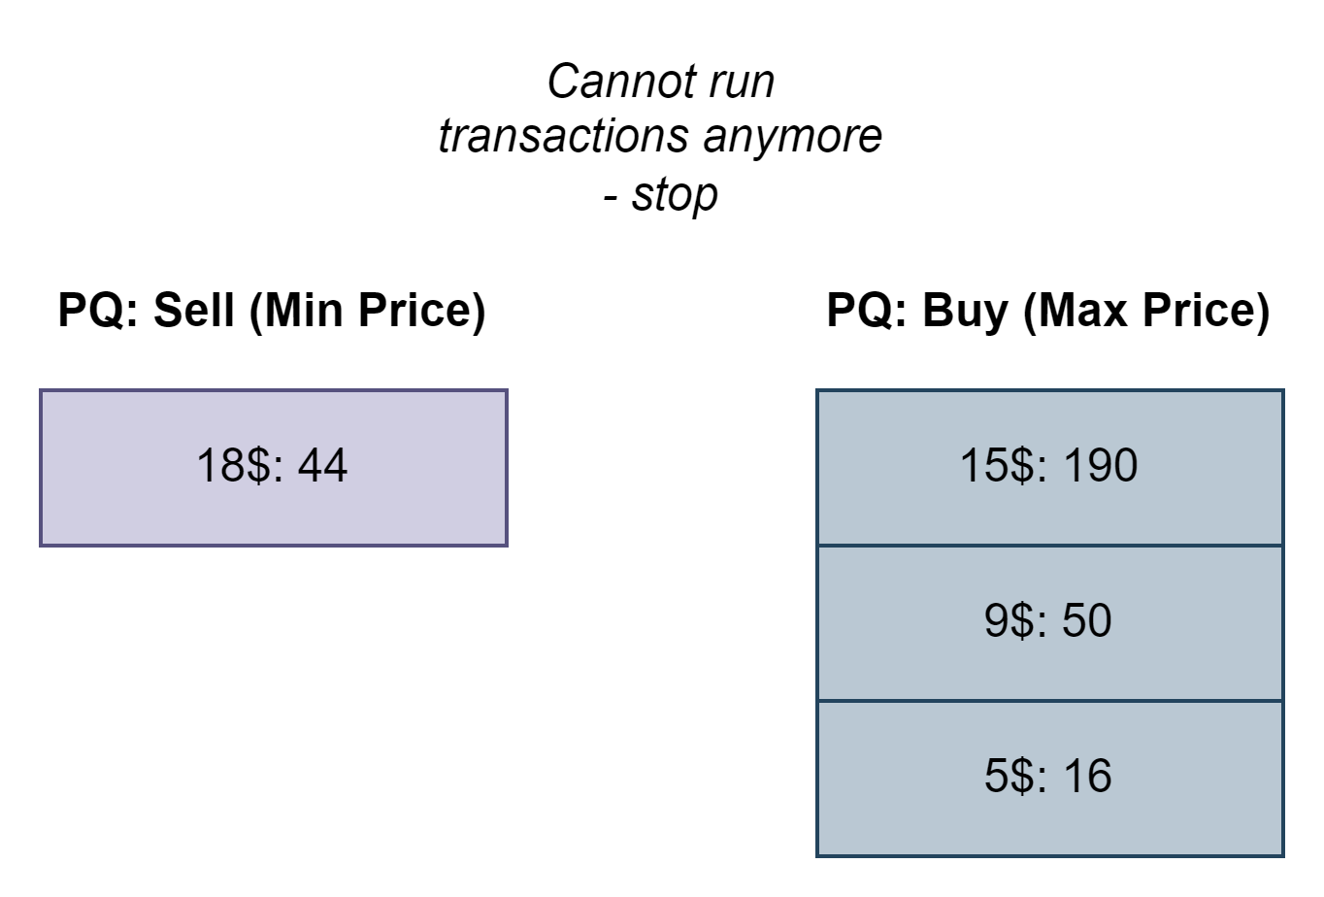



Priority Queue – Stock Prices – Approach
Kattis: Stock Prices

